Slide 1
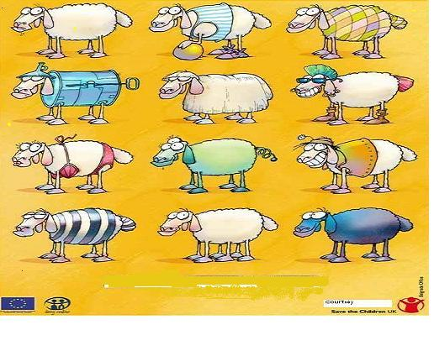
Training Programme on Leveraging Technology for DIVYANG
Digital Initiatives for Divyang
October 10, 2023
ALL EQUAL
ALL DIFFERENT
Dr. Anupam Ahuja
Former Professor, Head Department of Education of Groups with Special Needs (DEGSN) and Head International Relations Division
NCERT, New Delhi, INDIA
ahujaa56@gmail.com

Slide 2
Presentation Outline
National Policies for promoting Digital Content
NCERT's Digital initiatives for promoting Inclusive classrooms
      Understanding Inclusive classrooms
      Reading Series for All- An innovative UDL based Exemplar
      UDL in games
      Accessible Textbooks for All
      Other initiatives

Slide 3
Presentation Outline
National Policies for promoting Digital Content
NCERT's Digital initiatives for promoting Inclusive classrooms
      Understanding Inclusive classrooms
      Reading Series for All- An innovative UDL based Exemplar
      UDL in games
      Accessible Textbooks for All
      Other initiatives

Slide 4
National Policies for promoting Digital Content
July 2015 | Digital India programme with a vision to transform India into a digitally empowered society and knowledge economy launched by Hon' Prime Minister
Sep. 2017 | DIKSHA, a national platform for school education launched to provide accessible e-content to all learners across all the States of India
July 2020 | NEP-2020 launched by Hon' Prime Minister, which laid special focus on use of digital technology to provide accessible content to CwDs
June 2021 | E Content Guidelines released by Hon’ble MoE to to ensure that Divyang can access digital content with equivalent ease

Slide 5
Presentation Outline
National Policies for promoting Digital Content
NCERT's Digital initiatives for promoting Inclusive classrooms
      Understanding Inclusive classrooms
      Reading Series for All- An innovative UDL based Exemplar
      UDL in games
      Accessible Textbooks for All
      Other initiatives

Slide 6
Moving towards inclusion: Change the System and not the child
Change the system to fit the need of All
children
In ordinary
Schools
In Special
Schools
No Access to
Schools
Other Children
Children with Special Needs
Children from disadvantaged homes

Slide 7
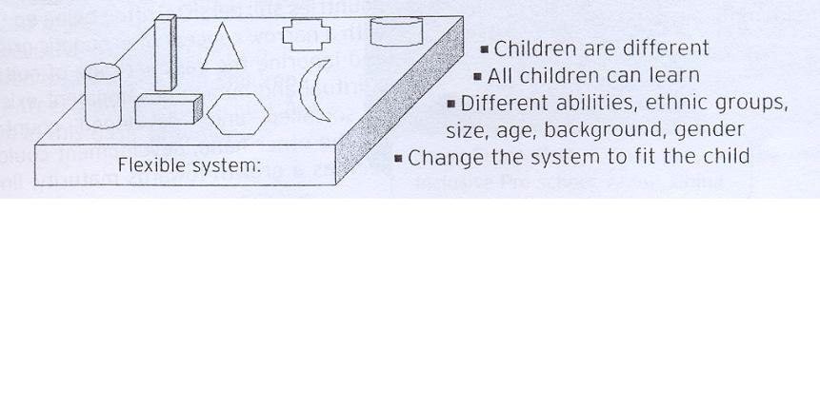
School Settings-Inclusive Education
Change the system to fit the child
Children are Different
All children can learn
Different abilities, ethnic groups, size, age, background, gender
FLEXIBLE SYSTEM
Source: Stubbs, S (2002 Inclusive Education: Where there are few resources;The Atlas Alliance, in cooperation with NAD
Source: Stubbs, S (2002 Inclusive Education: Where there are few resources;The Atlas Alliance, in cooperation with NAD
Indonesian Context Source: Implementation of IE in Indonesia-A persons Disabilities perspective; A presentation material by Didi Tarsidi

Slide 8
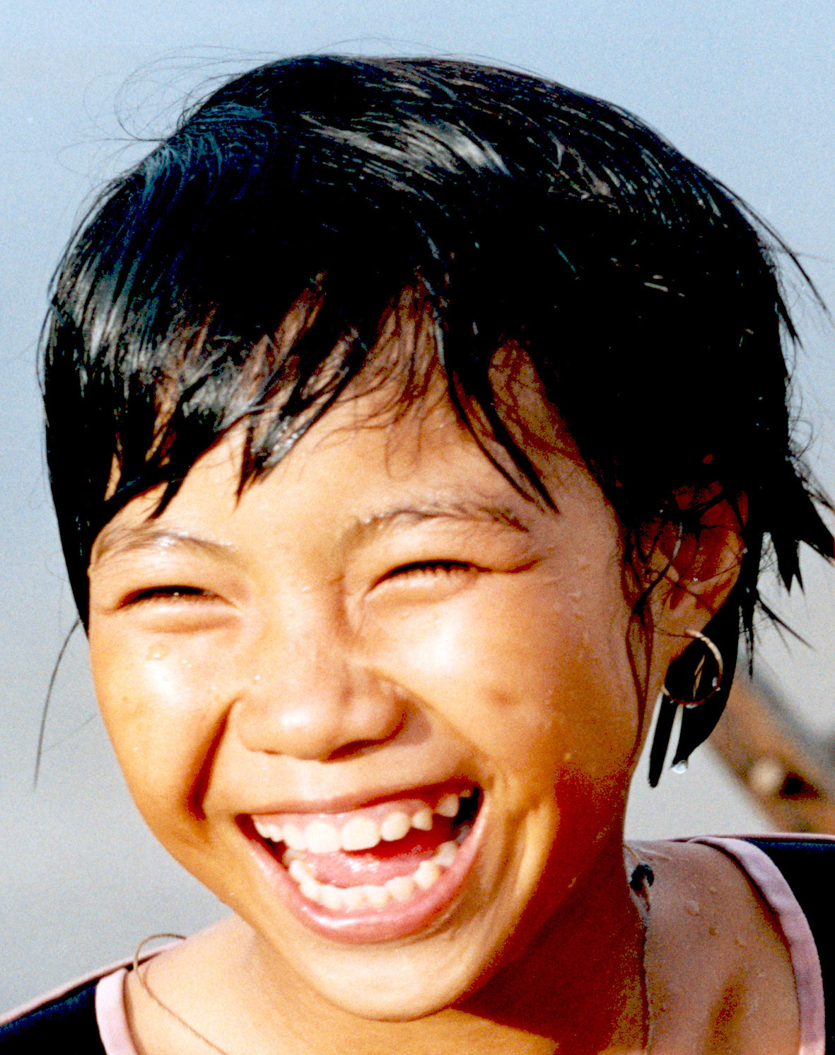
All for the Children
For All the children

Slide 9
Presentation Outline
National Policies for promoting Digital Content
NCERT's Digital initiatives for promoting Inclusive classrooms
      Understanding Inclusive classrooms
      Reading Series for All- An innovative UDL based Exemplar
      UDL in games
      Accessible Textbooks for All
      Other initiatives

Slide 10

Promoting Reading
FOR ‘ALL’
An Innovative UDL BASED Exemplar of
“A Reading Series for the early years” - 40 stories based on children's experiences set in the Indian Context

Slide 11
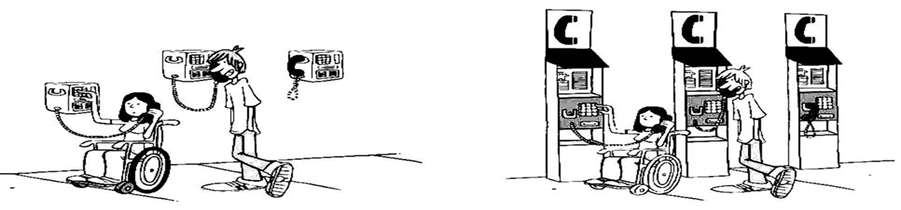
Universal Design For Learning( UDL)
No ‘single’, ‘one size’ fits all
Customized according to individual needs and requirements of all children
Non-UDL | UDL

Slide 12
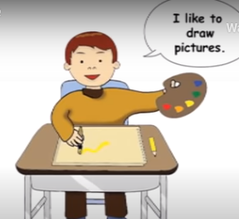
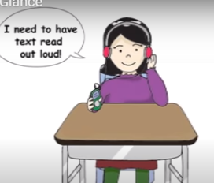
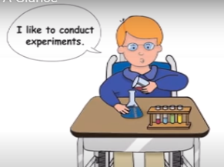
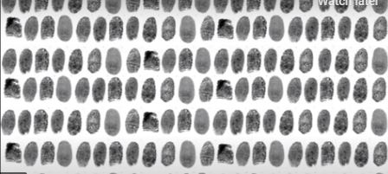
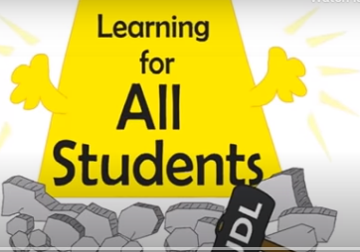
Universal Design of Learning (UDL)-An approach to address diversity
Children have varied background, strengths, needs, and interests
I learn when I see pictures
I learn when text is read loud
I learn when I conduct experiments
The way the children learn is as unique as their fingerprints (research based evidence)
UDL minimises barriers and maximising learning of each student

Slide 13
UDL Principles
Provide Multiple means of
Representation
Provide Multiple means of
Action and expression
Provide Multiple means of
Engagement
Present content and information in multiple forms
Print
Braille
Digital text with options for- text enlargement, screen background colour and contrast
Text to speech
Videos with closed captions,
Audio with transcripts,
Audio books
Sign Language
Give students multiple options of expressing what they know
  Assignments
  Painting
  Video
  Comic strip
Optimise access to assistive technologies
Provide feedback
Give option that engages all students
  What fires one student won’t fire up another!
  Give students choices to fuel their interests and autonomy
  Help students risk mistakes and learn from them. If they love learning they will persist through challenges

Slide 14
“Barkhaa Series” to “Barkhaa Series for All”
Department of Education of Groups with Special Needs (DEGSN) of National Council of Educational Research and Training (NCERT) developed a set of forty illustrated story booklets based on UDL principles.
The journey involved:
      National level workshops with multi- disciplinary teams
      Research based additional features
      Field Try-out
Meant for early readers with varied learning needs in inclusive settings
Available in print and digital formats

Slide 15





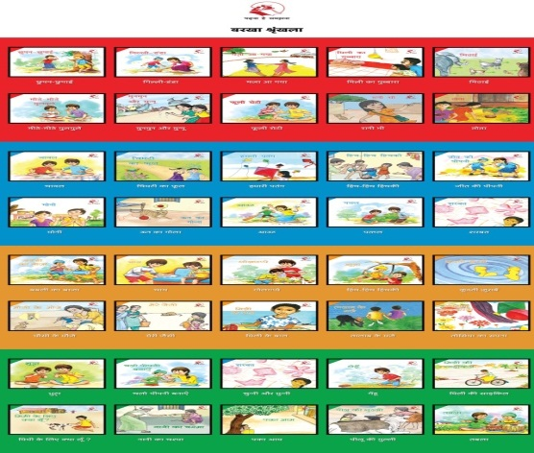
Adapted Barkhaa Series –
Key Features of Digital Version
Can be accessed on computers, laptops, mobile phones and tablets.
Retains all the features of the print version and has
      ‘How to Use’ page
      Content can be viewed in 3 different background colour combinations
      Option to increase size of text and image
      The introduction of each story in regular and sign language video formats-Helps to arouse curiosity and make reading interesting
      Flash cards appear highlighting key words and picture.
      Click/tap arrows on the black border to go to the previous or next page

Slide 16
Story Introduction : in Signed and regular forms
A child may have read any story e.g " Hide and Seek" (Chhupan Chhupai) with the additional features in the adapted booklet.
But what if the child does not know the " Hide and Seek" game and has never played this game?
Can we still help him read with meaning and pleasure?
An introduction to each story in video, regular and signed forms helps
      We all like to play games, some inside homes and some others outside. In this story children are playing Hide and Seek. One child looks for others who are hiding. Let us see how Jeet , looks for Babli and his other friends hiding in different places both inside and outside the home. Does he find them all or does he need some help?
      Let us read the story Hide and Seek!

Slide 17
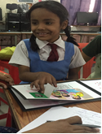
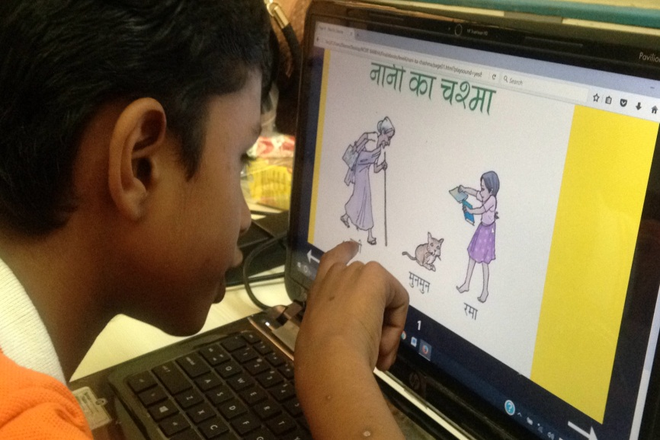
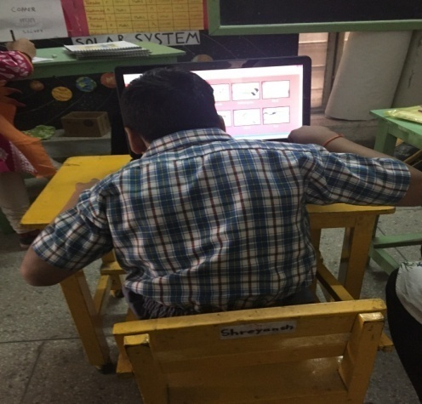
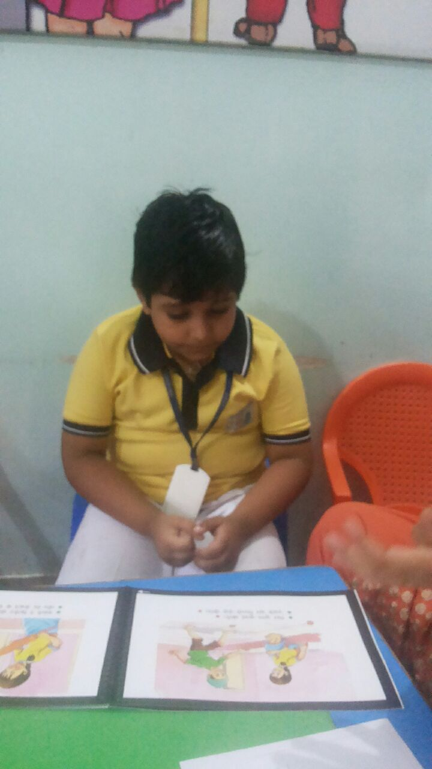
Innovation based on Tryout of Print and Digital Versions
Feedback Tryout analysed and incorporated in both Print and Digital Versions
Try out at Maharani Gayatri Devi Girl's School, Jaipur, Rajasthan
Try out of the Digital booklet at Umang, Jaipur, Rajasthan
Try out of the Digital booklet at Saksham , Delhi
Try out at Blossoms School, Bhubaneswar
Notes:
Both the print version and the digital version have been tried out in the field. Inputs from these tryouts have been analysed and incorporated in the final books.

Slide 18
Looking Ahead……
Children’s early experiences with the features of this inclusive learning material will lead them to demand similar material in later school years.
It is not enough to talk about inclusive education, One must believe in it
It is not simply enough to believe in it, One must continue to work at it!

Slide 19
Presentation Outline
National Policies for promoting Digital Content
NCERT's Digital initiatives for promoting Inclusive classrooms
      Understanding Inclusive classrooms
      Reading Series for All- An innovative UDL based Exemplar
      UDL in games
      Accessible Textbooks for All
      Other initiatives

Slide 20
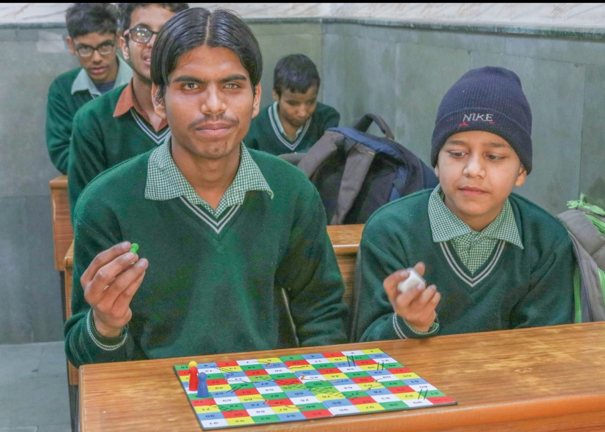
UDL BASED GAME- Snakes and Ladder
Ramu a sighted child is playing with his board game Snakes and Ladder alone.
Brij who is blind and much older, has just joined school. He comes and sits by Ramu in the class.
CAN THEY PLAY together?
Both of them need to follow what is written and printed on the Playing Board.
Can any additional features can facilitate their play together?

Slide 21

Additional Features facilitate playing together
Embossed Snakes and ladder on the playing board
Dice is tactile and makes sound when toppled
Tokens of the game are magnetic and do not fall off the board
Tokens also have tactile marking to differentiate the color
Packaging : allotted space for tokens and dice,portable and easy to carry

Slide 22
Playing Together : Lessons drawn
WHILE CHILDREN PLAY TOGETHER
They realise that they can both play with a game that looks like any other board game.
OUR LEARNING
UDL material like this in the classroom encourages children's interactions and helps make learning fun!
Helps lay the foundation for inclusion
All children feel equally empowered
Subtly reinforces that no child needs extra help or assistance all the time!

Slide 23
Presentation Outline
National Policies for promoting Digital Content
NCERT's Digital initiatives for promoting Inclusive classrooms
      Understanding Inclusive classrooms
      Reading Series for All- An innovative UDL based Exemplar
      UDL in games
      Accessible Textbooks for All
      Other initiatives

Slide 24
Accessible Textbooks for All
Based on the principles of UDL and Inclusion, NCERT has also ddeveloped exemplar “Accessible Textbooks for All” with focus on children who are widely excluded from activities of reading and learning due to special needs
Fundamental premise : Reading is a basic right that must be made available to ALL children

Slide 25
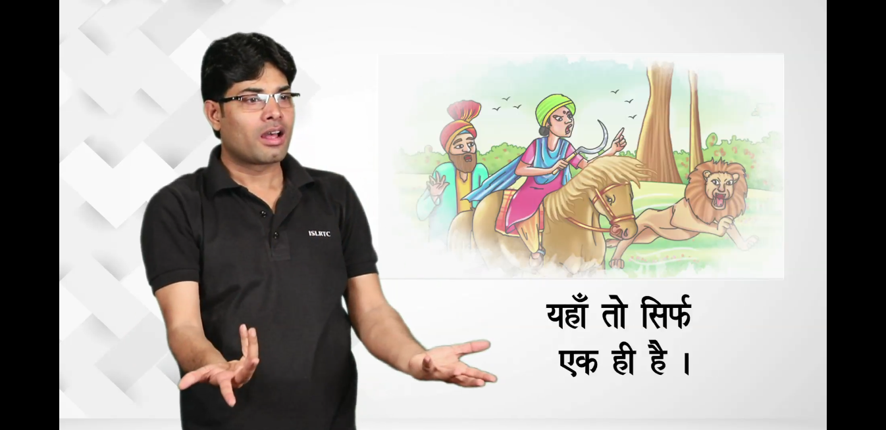
Beginning the journey
Stories and poems from NCERT Textbooks of Class I to V being adapted into multi-media modes:
  Sign language videos with:
    Illustrations,
    Audios,
    Sub titles and
    A teacher using sign language
Allows learners and educators to choose from amongst multi-media .
Counters the idea that printed textbooks are the only medium for the reading process
Fills in a crucial gap by going beyond the ”one-size fits all approach”

Slide 26
Features of Audio Tracks
Two type of audio tracks
  “Audio track with highly dramatic story telling”- dramatization, voice modulation, and sound effects that enhance the effect and emotion of the story.
  “Audio track with fluent reading”, paced and without sound effects. Students can listen to the story while reading the text on their own
Option for students to choose either of above audio tracks to suit learning style
Introductory Section - to arouse curiosity, build interest, and scaffold the story or poem
Concluding Section : Open-ended question on the story/poem- based on the students individual thinking.
Glossary of difficult words and difficult signs appended to each story and poem.

Slide 27
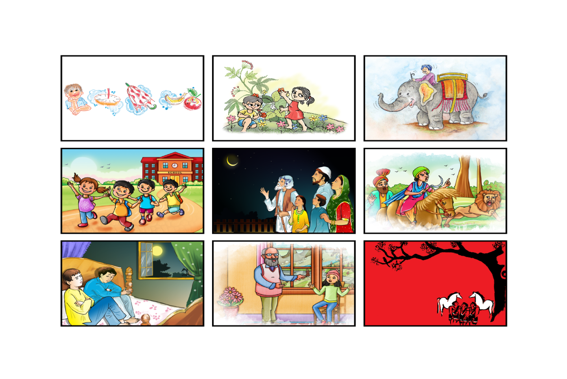
Stories and Poems from class I to V NCERT Textbooks adapted under the Accessible Textbooks for 'All' initiative.
National Anthem
Jana Gana Mana
Stories and folktales
Bahadur Bitto
Ek Din ki Badshahat
Who will be Ningthou
Idgah
Chuskit Goes to School
Poems
Chakai ka Chakdum
Hathi Challam Challam
Purane Bachche
Koi Laake Mujhe De

Slide 28
International collaboration for accessible textbooks for all initiatives
Collaborative project between NCERT and National Institute of Special Education (NISE) Republic of Korea( RoK)
Adapting key stories and poems from textbooks that have been enjoyed by generations of readers and form the backbone of literary curriculum in the country.
Works towards revolutionising reading material on the principles of Universal Design for Learning and Inclusive Education

Slide 29
Presentation Outline
National Policies for promoting Digital Content
NCERT's Digital initiatives for promoting Inclusive classrooms
      Understanding Inclusive classrooms
      Reading Series for All- An innovative UDL based Exemplar
      UDL in games
      Accessible Textbooks for All
      Other initiatives

Slide 30
Accessibility in NCERT Text books-Other Initiatives
E-patshala Digital Textbooks ( Class 1- 12) in all subjects
E-patshala Mobile App- Text To Speech (TTS)
Sign Language Video Programmes
Tactile Map Book with Audio programmes
Audio Books

Slide 31
Presentation Outline
National Policies for promoting Digital Content
      Guidelines for the development of e-Content for Divyang Children
NCERT's Digital initiatives for promoting Inclusive classrooms
      Understanding Inclusive classrooms
      Reading Series for All- An innovative UDL based Exemplar
      UDL in games
      Accessible Textbooks for All
      Other initiatives

Slide 32
Guidelines have been framed with an aim to promote equitable and inclusive education
SDG Goal 4
NEP 2020
RPwD Act 2016
“Ensure inclusive and equitable quality education and promote lifelong learning opportunities for all”
“Equitable and Inclusive Education- Learning for All- Provide Children With Disabilities, the same opportunities of obtaining quality education as any other child”(para 6)
Schools to provide inclusive education -students with and without disability learn together and the system of teaching and learning is suitably adapted to meet the learning needs of students with disabilities
The common thread that runs through Acts, Policies and Conventions is provide
“Equitable Opportunities and Inclusive Education to All Children”
The guidelines are aimed to promote development of high quality accessible content for children with disabilities and strengthen momentum for “Inclusive Classrooms” as envisioned in NEP-2020

Slide 33
Section wise Contents
Overview |  | EXECUTIVE SUMMARY
Section-1 | : | INTRODUCTION
Section-2 | : | DISABILITY CENSUS AND RIGHTS OF PERSONS WITH DISABILITIES
Section-3 | : | ACCESSIBLE E-CONTENT: ESSENTIAL COMPONENTS AND TECHNICAL STANDARDS
Section-4 | : | RECOMMENDED TECHNICAL STANDARDS, GUIDELINES AND POLICY MEASURES
Section-5 | : | GUIDELINES FOR ADAPTION OF PRINTED TEXTBOOKS INTO ACCESSIBLE DIGITAL TEXTBOOKS(ADTs) FOR ‘ALL’ CHILDREN BASED ON UDL PRINCIPLES
Section-6 | : | GUIDELINES FOR E-CONTENT FOR STUDENTS WITH INTELLECTUAL DISABILITIES, AUTISM SPECTRUM DISORDER, MENTAL ILLNESS, MULTIPLE DISABILITIES AND BLOOD DISORDERS
Section-7 | : | GUIDELINES FOR E-CONTENT DEVELOPMENT FOR CHILDREN WITH SPECIFIC LEARNING DISABILITIES (SLD)
Section-8 | : | GUIDELINES FOR E-CONTENT FOR STUDENTS WITH BLINDNESS AND LOW VISION
Section-9 | : | GUIDELINES FOR E-CONTENT DEVELOPMENT FOR DEAF AND HARD OF HEARING STUDENTS
Section-10 | : | SUMMARY OF RECOMMENDATIONS
Section-11 | : | SUGGESTIONS TO IMPROVE COMPLIANCE TO ACCESSIBILITY AND IMPLEMENTATION ROAD MAP
Appendix-1 | : | GUIDELINES FOR PRODUCTION OF SIGN LANGUAGE VIDEOS
Appendix-2 | : | UDL GUIDELINES

Slide 34
Guidelines have been framed based on four cardinal principles
Equivalent ease of
access to children with disabilities
Perceivable
Operable
Understandable
Children should be able to perceive the content using any sense (sight, touch, hearing)
Children should be able to control and manipulate the entire content using any of the interface (mouse, keyboard, etc.)
Children should be able to understand and comprehend the content and operations (instructions, how to use, etc.)
Robust
Children should be able to access content on wide range of devices (desktop, laptop, smartphone, etc)

Slide 35
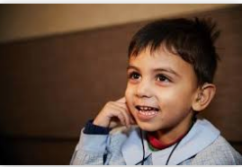
Learnings from development and field testing of exemplar materials embedded in the guidelines
Guidelines are based on learning of:
Development of exemplar materials by NCERT based on the Principles of UDL(Universal Design for Learning)
Development of prototypes of ADTs(Accessible Digital Textbooks )by UNICEF and its partners
If a child can’t learn the way we teach, may be we should teach the way they learn.”- Ignacio Estrada

Slide 36
Pedagogical Guidelines- A few Examples
Based on the experience of Barkhaa Series for All
Provide introduction to the topic in the mother tongue/dominant language and sign language at the beginning of each section/topic.
Provide instruction on “how to use” (in mother tongue/dominant language and sign language) .
Provide descriptive hyperlinks to access supplementary /additional material.
Use simple, easy to read language.
Provide glossary linked to specific words.
Explain new concepts in multiple ways - diagrams with description , descriptive interactive models, flow charts, decision trees etc.
Provide a linkage between the textbook concepts and activities by showing images that support the purpose of the activity.
Test the content with actual target groups before it is uploaded on the portal.

Slide 37
Standards and Guidelines for all three components have been recommended
Inter-linked Components of Accessible e-Content
Compliance of guidelines for during authoring and Publication will lead to “Born Accessible” learning material
Section 5 exclusively provides guidelines to develop Accessible Digital Textbooks (ADTs) for ALL
Pedagogy
Content
Content
Technology
Guidelines can be used for developing e-Content both academic and other content including self helpskills

Slide 38

Guidelines are dynamic and will be calibrated based on implementation experience and technology advents
Numerous webinars and virtual workshops have already been conducted to disseminate and get feedback for improvements
Guidelines comprising of 11 Sections and 2 Appendices can be downloaded from MoE/NCERT websites free of cost
https://www.education.gov.in/sites/upload_files/mhrd/files/CWSN_E-Content_guidelines.pdf

Slide 39
Thank you

